Slide 1
Industrial Project - 234313 3D map evolution - PTC
Supervisors: Eldad Finkelstein, Mordecai Sayag
Students: Saja Yassin, Marwan Billan

Slide 2
Introduction
3D model is becoming more important and applicable than ever before. It is being used for industrial, medical and academical purposes. In large scale scenes, rescanning of the entire scene can be expensive and time consuming.
Therefore, in this project we want to make the process more efficient, by scanning the evolved portions only and fuse them to the 3D model base .

Slide 3
Goals
Main project objective:
The goal is to create an algorithm/code that decides by color images (of the 3D model and from the scanning device - Hololens) if the real world has changed and what kind of update is required.

Slide 4
Relevant Paper
We have found the following paper that discusses “Image Comparison Methods & Tools” topics.
One of the discussed topic is “Feature Based Image Comparison”, which gave us a basic direction to investigating the problem.
A link to the paper:
https://www.academia.edu/19962797/Image_comparison_Methods_and_Tools_A_Review?fbclid=IwAR29xwjbNTpjcEVJNLA988qm7j1qqt23iv0yP6evFjyqvZOUXw3d_YJKICM

Slide 5
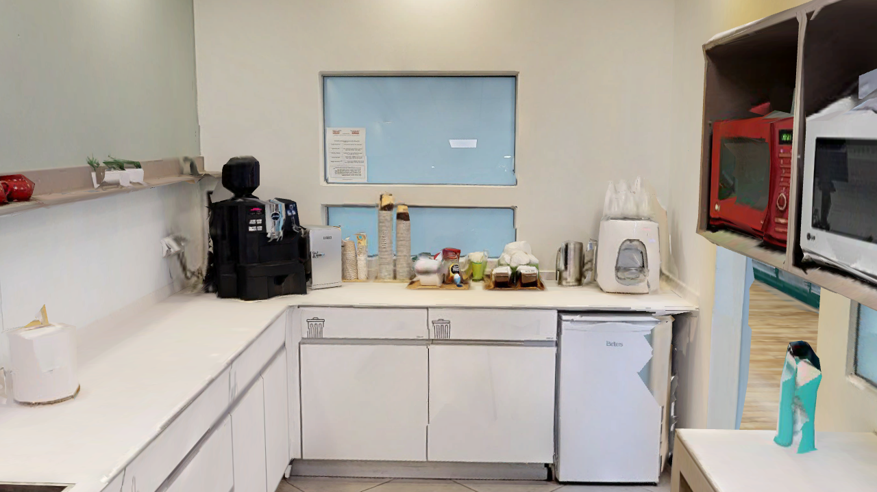
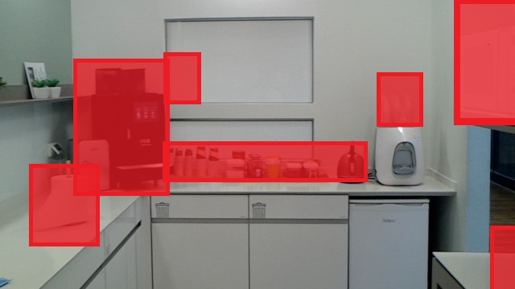
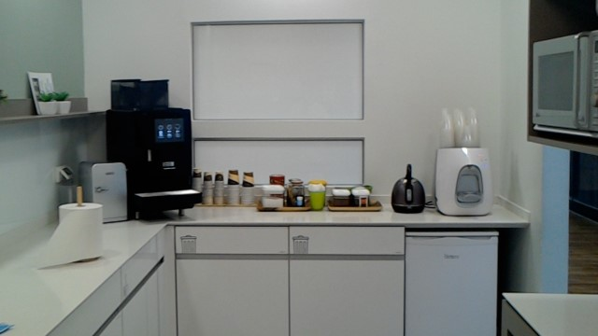
Input and output example
Synthetic image – captured by Hololens
Desired output
Real image – captured by phone

Slide 6
Our solution – in details
Align the two images and resize them:
Run Dense-Sift on the two images .
Find matching feature points from the synthetic to the real image using Knn matcher (with k=2).
Filter the matched feature points using these methods:
For each two matched pointes discard the pair with big distance (the distance is defined by Knn matcher).
Find a Homography from the synthetic to the real image using Ransac, and then discard all the feature points that don’t match the Homography - where the following distance is bigger than some threshold: The distance we measure is between the source feature points after applying the transformation and the destination feature points.
Crop the synthetic image according to the generated Homography.
Resize the cropped image to fit the real image. (According to the definition of the project, the synthetic image contains the real image.)

Slide 7


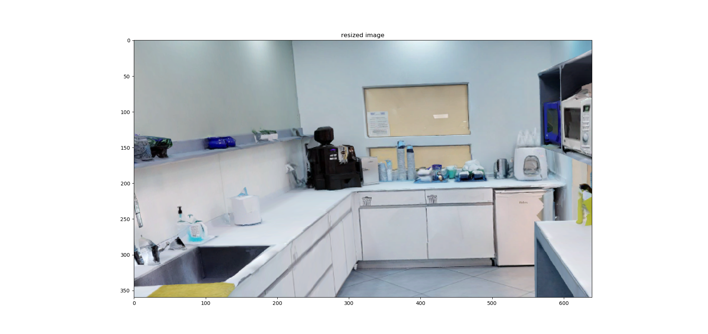
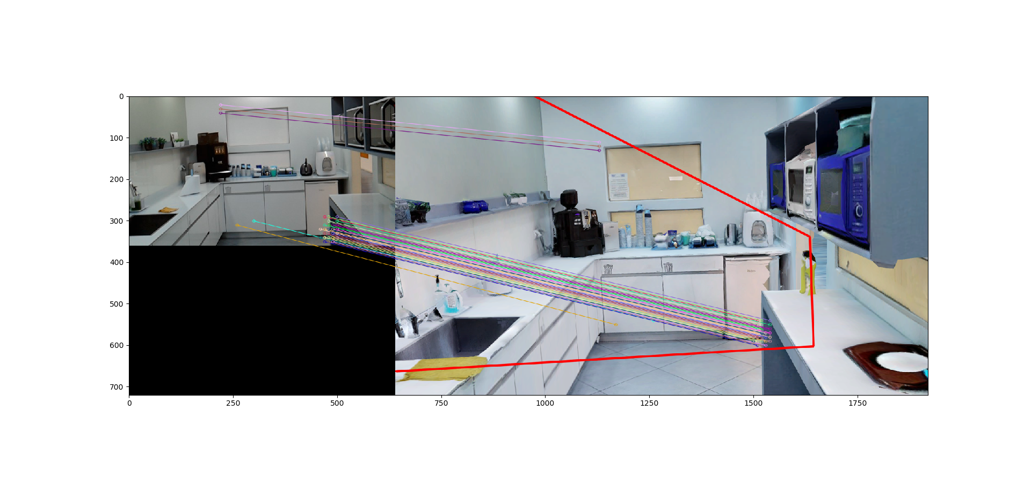

Resized synthetic image
Real Image
Synthetic Image

Slide 8
2. Find matches from the synthetic to the real image.
Run Dense-Sift on the two images to find feature points.
Find matching feature points from the synthetic to the real image using Knn matcher (with k=2).
To optimize the matched feature pointes use the filter methods mentioned in section 1.
For each matched feature point sign the surrounding as unchanged area on the real image.

Slide 9
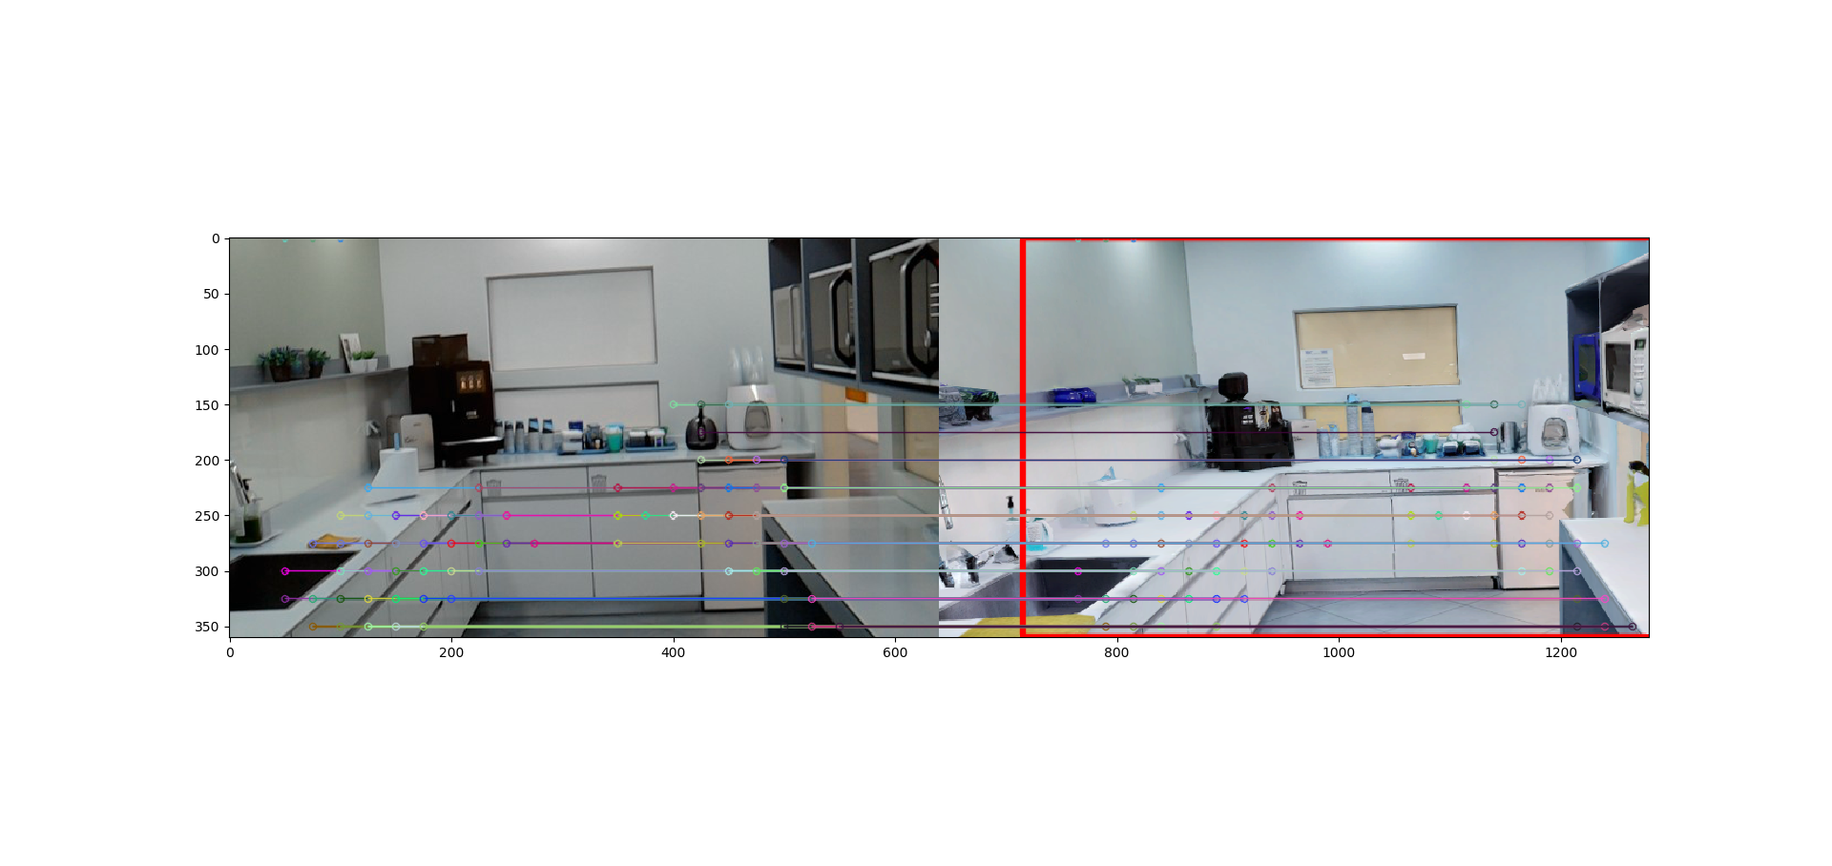
Real image
Synthetic image

Slide 10
3. Find matches from the real to the synthetic image.
Find the matching feature points the same as in section 2.
For each matched feature point sign the surrounding as unchanged area on the real image.

Slide 11
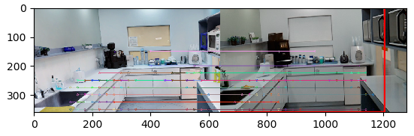
Real image
Synthetic image

Slide 12
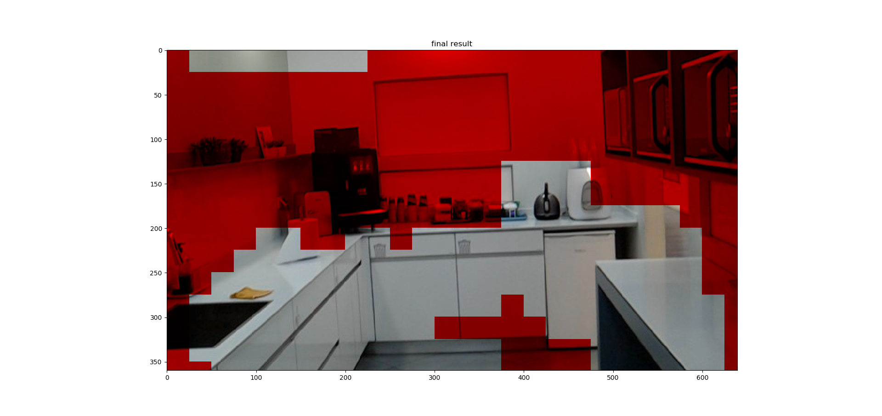
Colored image
The red portion is the changed portion of the scene.

Slide 13

Mask image
The black portion is the changed portion of the scene.
The white portion is the unchanged portion of the scene.

Slide 14
Our solution – in pseudo
GetPerfectMatch(synthetic image, real image):
Synth, real ← synthetic image, real image
fp_synth, fp_real← Dense-Sift(synth, real)
matches_array← KnnMatches(fp_synth, fp_real)
filter matches_array:
homography_matrix, matches_mask ← findHomography(good_matches, fp_synth, fp_real, Ransac)
perfect_matches ← good_matches[matches_mask]
Return perfect_match, homography_matrix
good_matches = []
for m,n in matches_array: if m.distance < gamma_goodness*n.distance: good_matches.append([m])

Slide 15
Pseudo…
Main(synthetic image, real image):
Synth, real ← synthetic image, real image
perfect_matches, homography_matrix ← GetPerfectMatch(synth, real)
resized_synth ← Resize(Crop(homography_matrix(synth)), sizeOf(real))
perfect_matches1, _← GetPerfectMatch(resized_synth, real)
perfect_matches2, _← GetPerfectMatch(real, resized_synth)
Mask ← CreateMask( union(perfect_matches1, perfect_matches2))
Return Mask

Slide 16
Project management
We had weekly meetings with the mentor in order to:
Introduce us to the product we are going to enhance.
Define the specification of the project (input, output, dataset, etc...).
Guide us to necessary materials that can fill our knowledge gap .
Mentor our progress and give us academic advice.
Supply us with real dataset.
We (the students) had weekly meetings, in which we learned, experimented, developed and tested our program.

Slide 17
Project management
Difficulties:
Filling the knowledge gap, especially that we didn’t have organized resources, like we are used to in other academic courses.
Working on real vs. real images and then adapt our solution to work on real vs. synthetic images.

Slide 18
Experimental Methodology
Our program contains multiple parameters that can affect the output. Therefore, we ran tests with different values of these parameters:
Step size: the density of the feature points used in part 2 or 3, (the resolution of the solution).
ransac_reproj_threshold: the Ransac error threshold (see ransac_reproj_threshold parameter in cv2.findHomography).
max_iters: the maximal number of iterations that Ransac will do before returning the transformation (see maxIters in cv2.findHomography).
The main goal of the testing would be to evaluate how good and precise can our program detect changed areas.

Slide 19
Experimental Methodology
We tested our program on 2 main datasets:
3 databases of couples of real vs. real images capturing a parking during a full day:
All results with step size 15, 20, 25 and 30 where one comparison was done between each two consequent images, while the other was done between the first image of the DB and all the other images: https://drive.google.com/file/d/11vINn1NhvEg4KfOqNFONhEs-mhgkmRWn/view?usp=sharing
Time-lapse videos for setp size 15: https://drive.google.com/drive/folders/1SbLk3D92ifLNieXlZ6ScGeCYJgvI2KdX?usp=sharing

Slide 20
Experimental Methodology
Couples of real vs. synthetic images taken from a phone and from the mesh of the company respectively:
In order to see how the parameters affect the result, we ran the program on several couples of real_synth images with different values of the parameters. E.g., for step size in [10, 20, 50, 100], maxIters in [1, 1000, 2000], reprojectionThreshold in [1,5,9]. Results: https://drive.google.com/file/d/1ZLeew_xshb5ZiA7iqFlY5PgxG_rcCeXh/view?usp=sharing
After analyzing the above examples, we decided that step size = 20, maxIters = 2000 and reprojectionThreshold= 9.0 give the best output for the given DB. Results: https://drive.google.com/file/d/1lKHsroZuTOFB8PenIV1k0tUfAFuAR0Z5/view?usp=sharing
In the following slides, we will present selected results.

Slide 21
The examined frame – kitchen

Slide 22

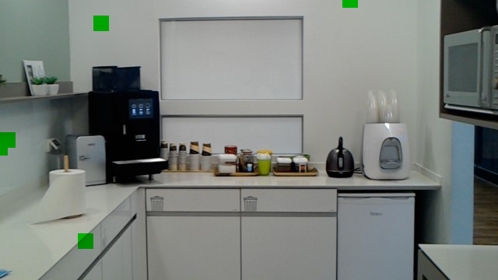
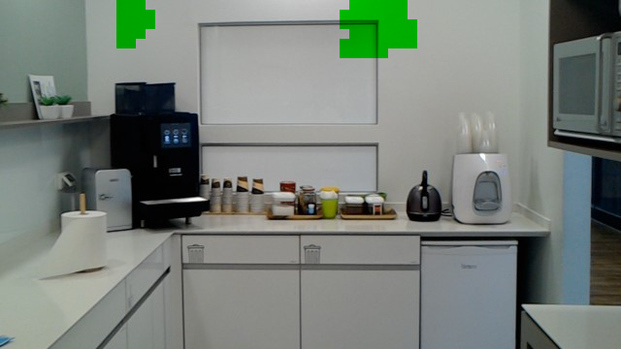
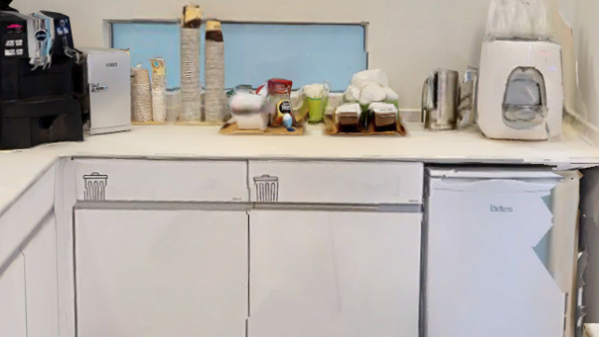
aligned image (after step1)
Result (the green indicate the unchanged)
stepSize10_maxIters1_reprojection9
stepSize10_maxIters2000_reprojection1

Slide 23
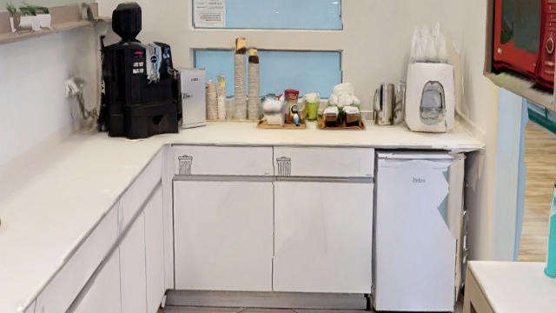
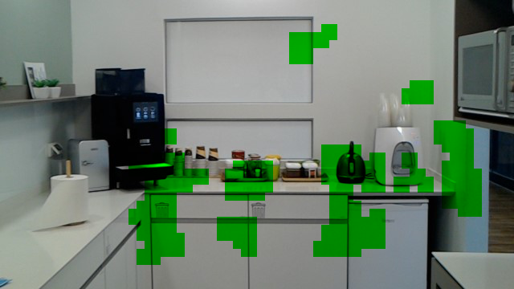
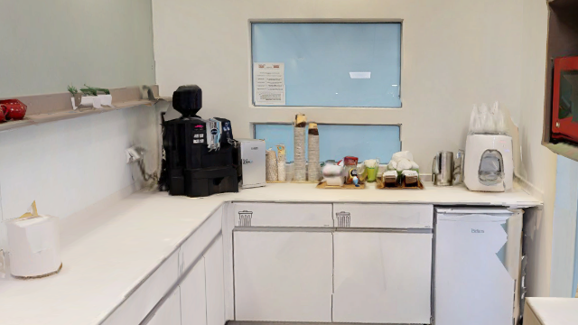
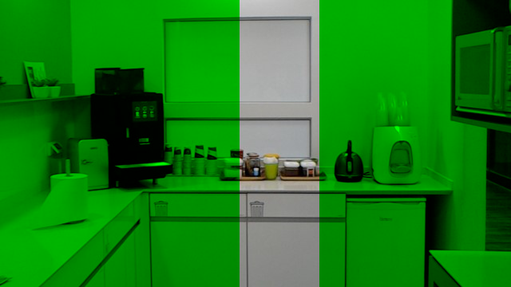
aligned image (after step1)
Result (the green indicate the unchanged)
stepSize10_maxIters2000_reprojection5
stepSize100_maxIters2000_reprojection9

Slide 24
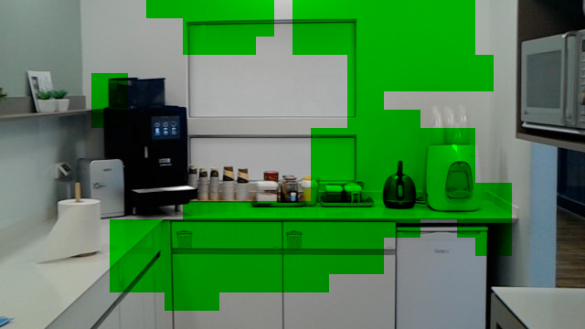
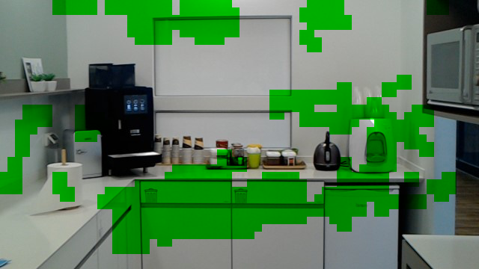
aligned image (after step1)
Result (the green indicate the unchanged)
stepSize20_maxIters2000_reprojection9
stepSize10_maxIters2000_reprojection9

Slide 25
Results and conclusions
Step size:
In the above results we can see that using large step sizes might cover huge areas when the change is small, where using small step sizes might select small portions of a larger change.
We observed in some of the experiments (especially in the real vs real), that the smaller the step is, the more small changes will be detected and the changes will be marked more accurately, but also the more we get false detected changes. (see an example of real vs real results with different step sizes in the following slides).
The smaller the step size is, the larger the run time will be – as expected - because small step size means dense feature points which means large number of feature points, therefore, the program will need more time to analyze, match and filter them.

Slide 26
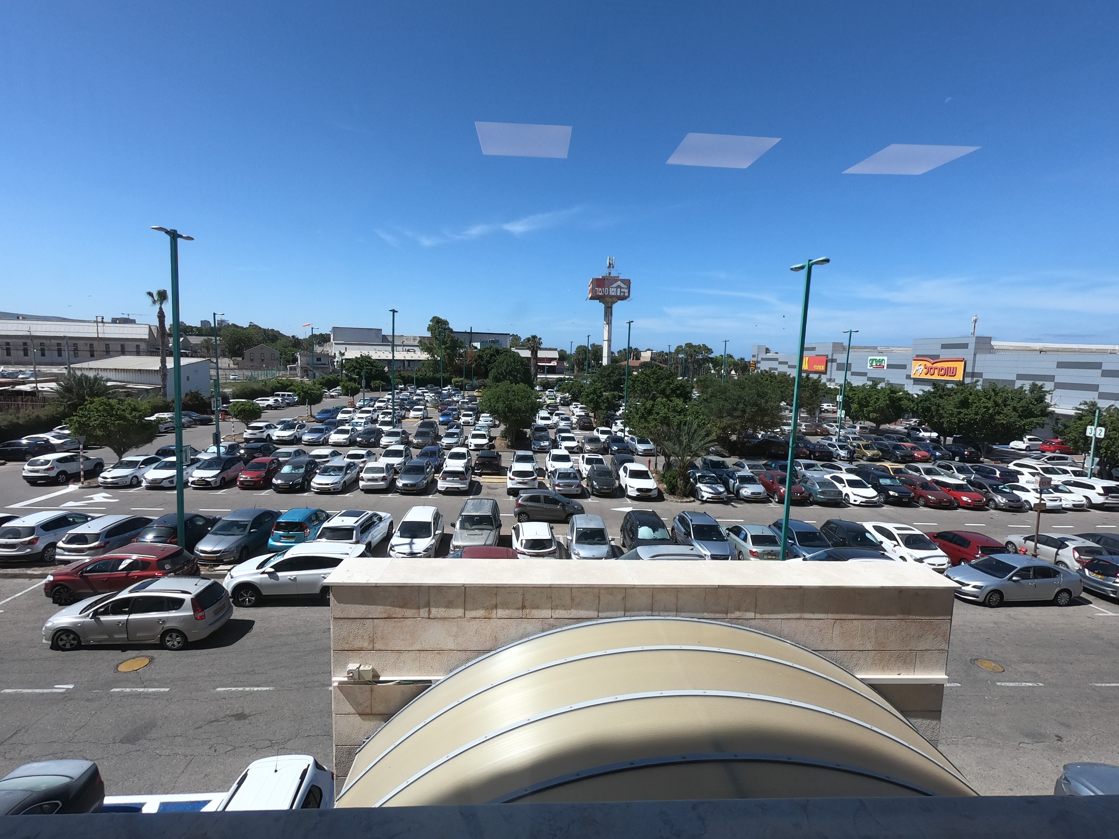

The examined frame
From 100GOPRO DB
Frame:G0020081.JPG
Frame:G0020080.JPG

Slide 27
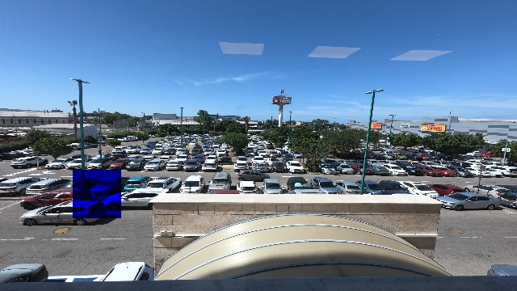
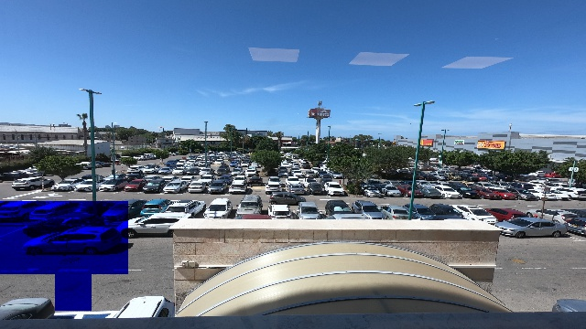
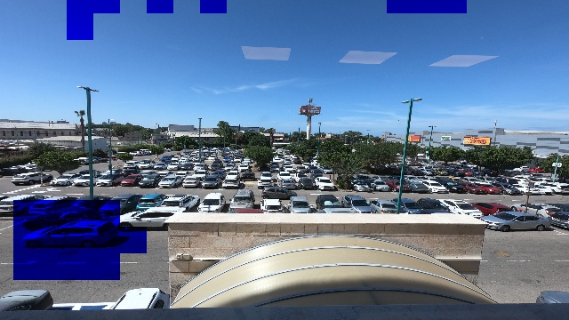
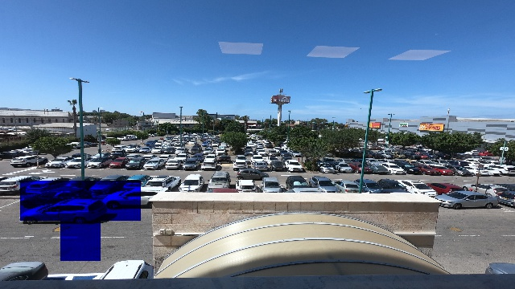
Step size 30
Step size 20
Step size 15
Step size 25

Slide 28
Results and conclusions
max_iters: when using larger max_iters, Ransac will make more iterations in order to find the transformation, which will lead to more accurate and better transformation. (we can see this result reflected in the kitchen examples). However, in some cases (e.g., when the images are not good enough) setting smaller values for max_iters may convey better results.

Slide 29
Results and conclusions
ransac_reproj_threshold: (range 0-10) Ransac reprojection threshold, it indicate the distance threshold between the source feature points after transformation and the destination feature points. Therefore, the smaller the threshold is the more strict the transformation will be, and the bigger the threshold is the more relaxed the transformation will be. In our experiments real vs real this parameter didn’t make much difference, but in real vs. synthetic, we had better results when we used big threshold. Possible explanation: the synthetic objects, in the synthetic image, don’t represent a prefect copy of the real objects. So we need to add some relaxation and use big threshold. In the next slide you can see an example that demonstrates this situation.

Slide 30
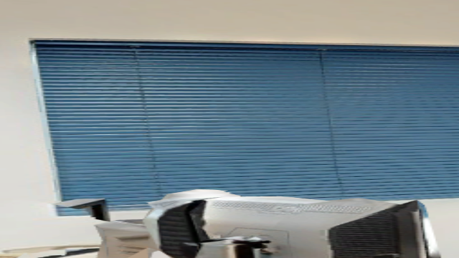
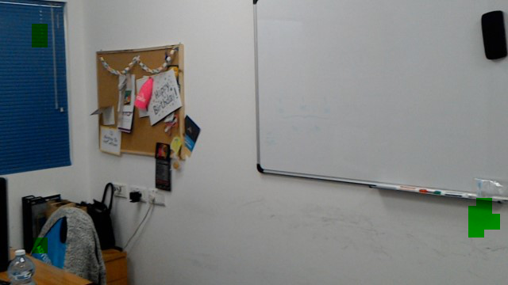
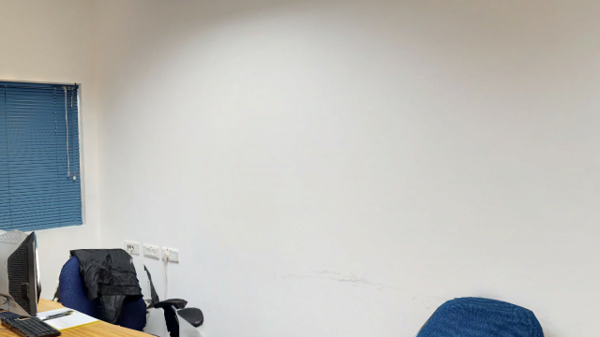
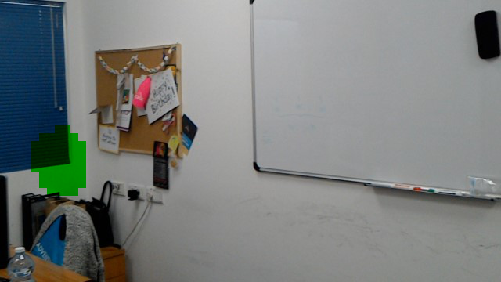
aligned image (after step1)
Result (the green indicate the unchanged)
stepSize10_maxIters10_reprojection1
stepSize10_maxIters10_reprojection9

Slide 31
Results and conclusions
In the first part of the algorithm (align the two images and resize them), in order to find feature points we tried sift , dense sift with step size in [25 ,15, 10] , dense sift with step size 15 had the best results:
 | Fail to find Homography | Found a false Homography
Sift | 0.066 | 0.46
Dense sift- step size 25 | 0.46 | 0.166
Dense sift –step size 15 | 0.066 | 0.066
Dense sift –step size 10 | 0.0 | 0.25

Slide 32
Results and conclusions
If Ransac failed to find Homography, the program would return that the whole frame has been changed.
If Ransac found false Homography, part 2 and 3 from the algorithm would fail, or maybe worse, it would mark some areas as unchanged (false negative), and since we prefer false positive over false negative, failing to find Homography is better than finding false one.
Link for the results that contain the resized images:
https://drive.google.com/file/d/1eiGW-ukk5jq9M69li1julPLgRHKj_XRL/view?usp=sharing
Note: in the result folders, a file with “None” suffix indicates failure to find Homography.

Slide 33
Future Work
The best parameters values for the program depend on the dataset, and can be very different form one dataset to another. ML can be used to predict the best parameters’ values to a given dataset.
Benchmarking over more variant datasets.

Slide 34
Summary
In this presentation we discussed our program that takes as input a synthetic image (captured by Hololens) and a real image.
It decides if the real world has changed and what kind of update is required to update the mesh.
Thank you very much
It has been fun ☺

